Slide 1

Instagram User Analytics

Slide 2

AGENDA

Slide 3
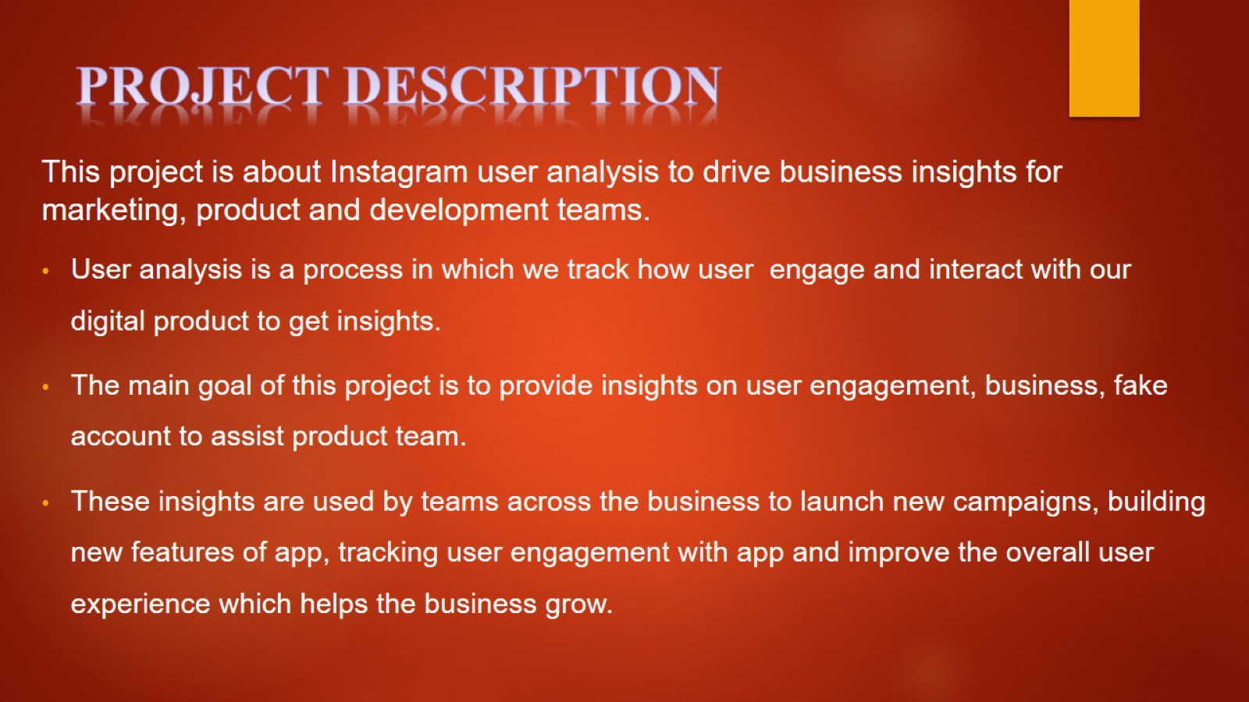
PROJECT DESCRIPTION

Slide 4
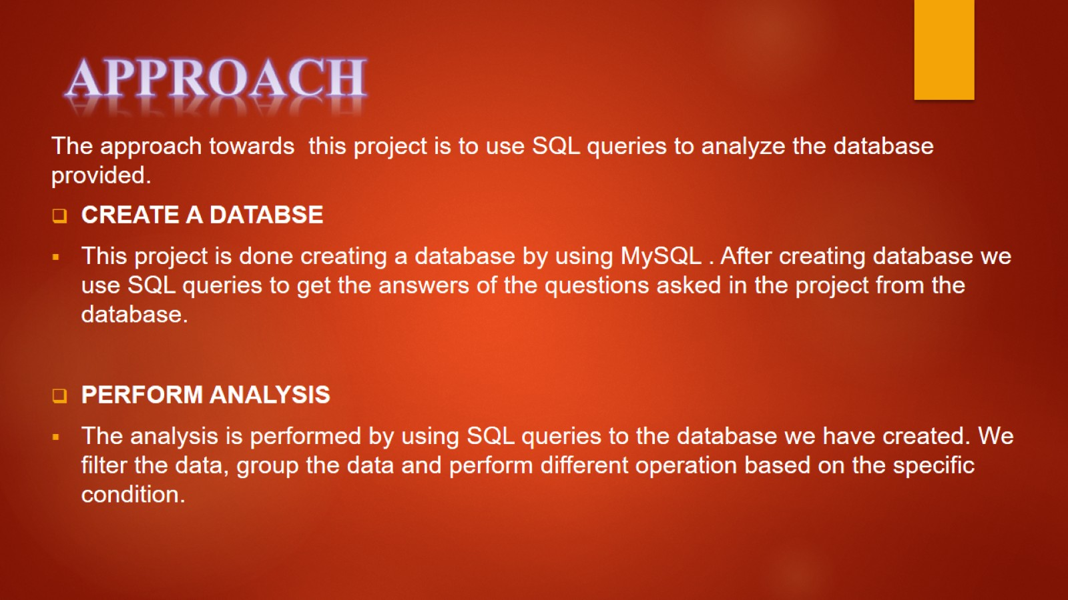
APPROACH

Slide 5
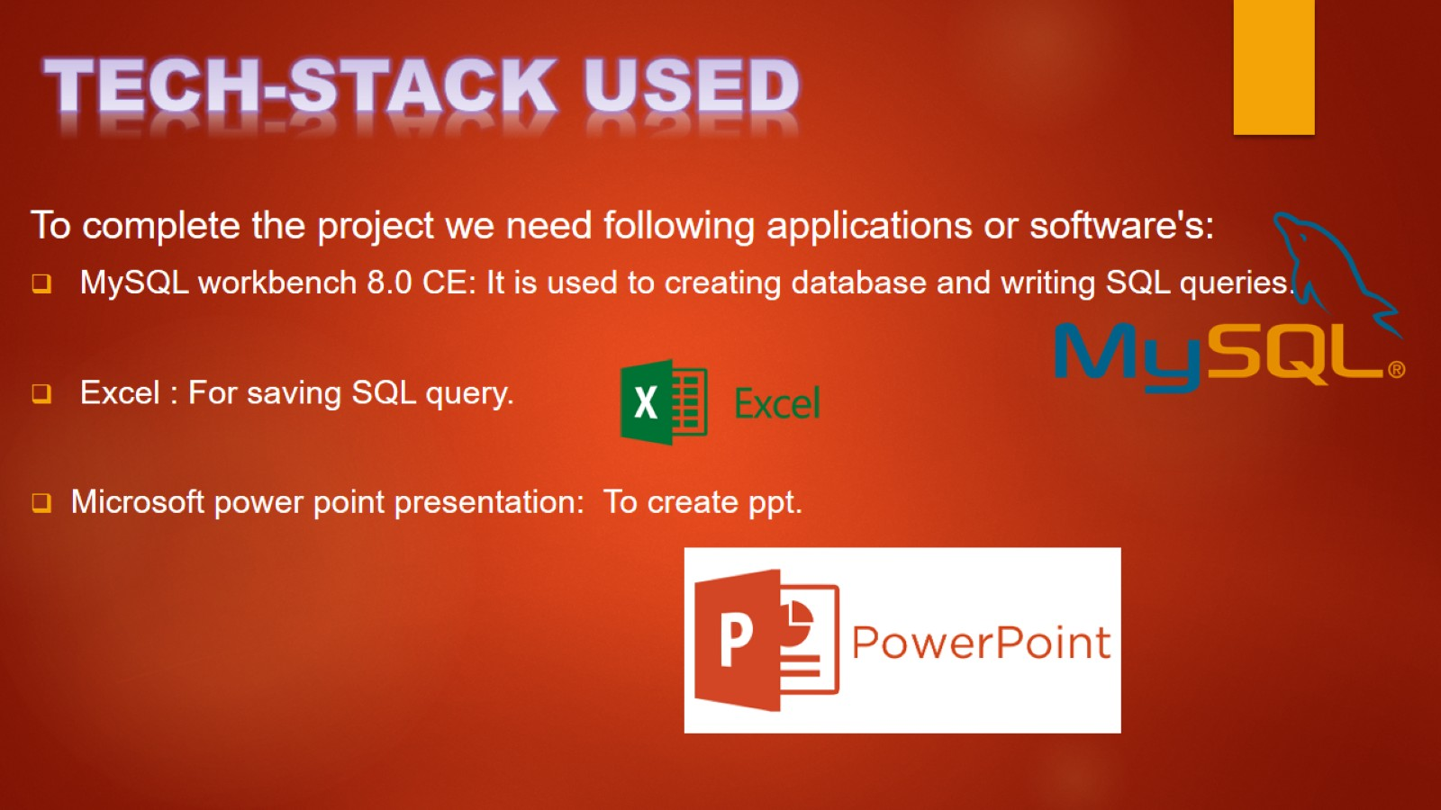
TECH-STACK USED

Slide 6

INSIGHTS

Slide 7
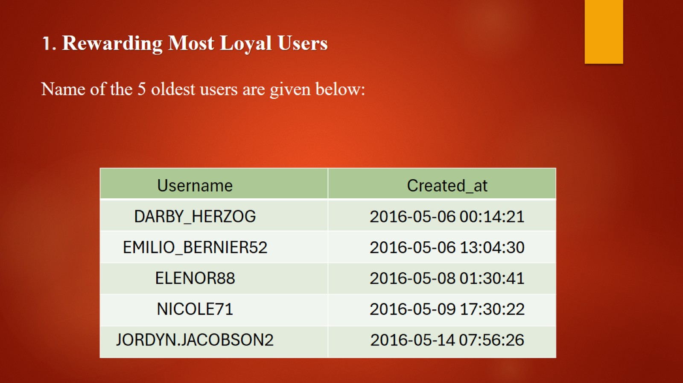
1. Rewarding Most Loyal Users Name of the 5 oldest users are given below:

Slide 8
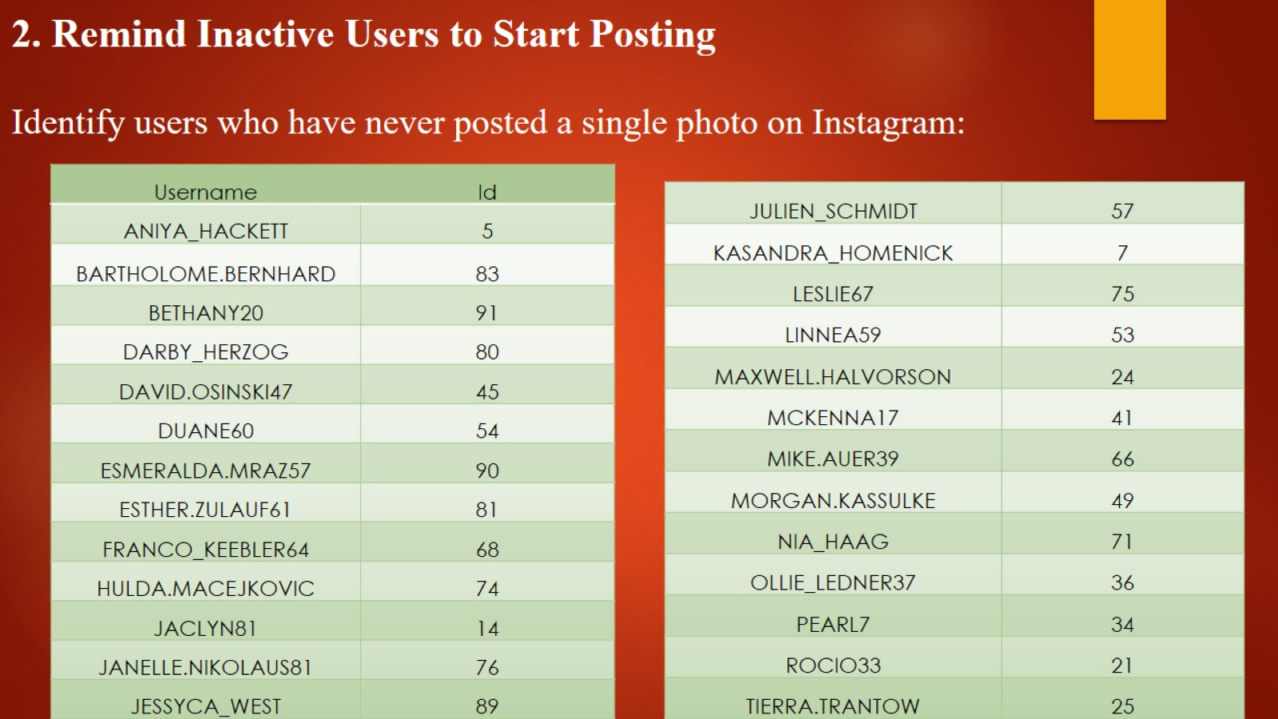
2. Remind Inactive Users to Start Posting Identify users who have never posted a single photo on Instagram:

Slide 9
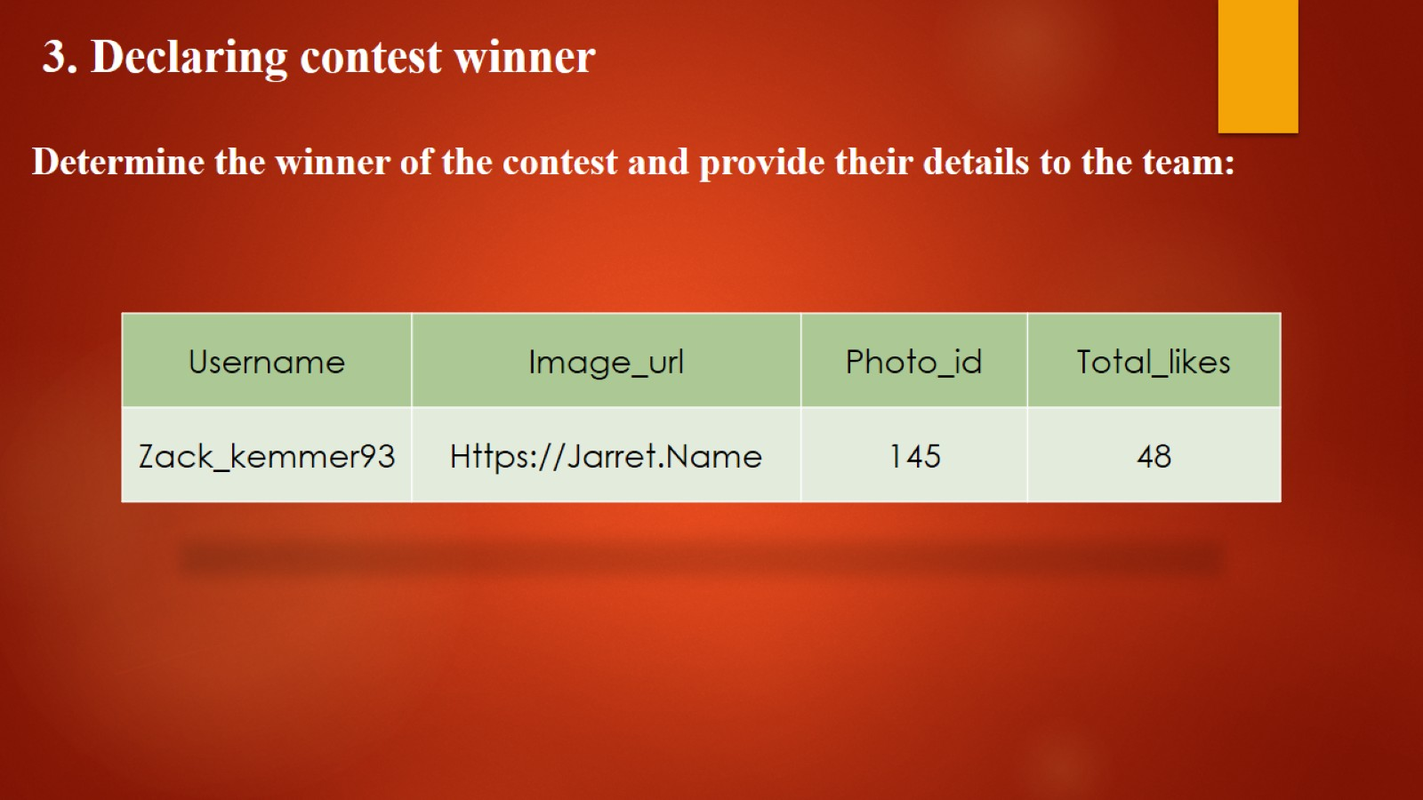
3. Declaring contest winner Determine the winner of the contest and provide their details to the team:

Slide 10
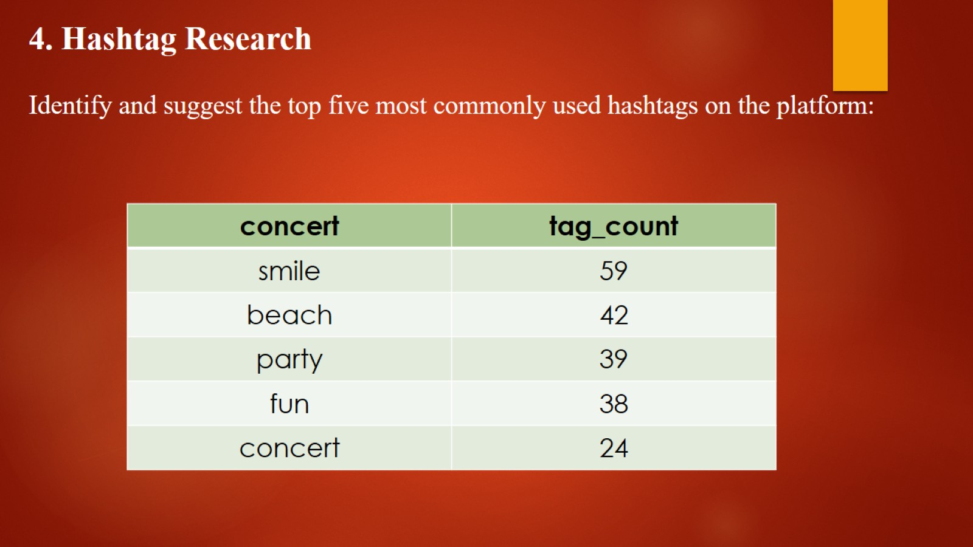
4. Hashtag Research Identify and suggest the top five most commonly used hashtags on the platform:

Slide 11
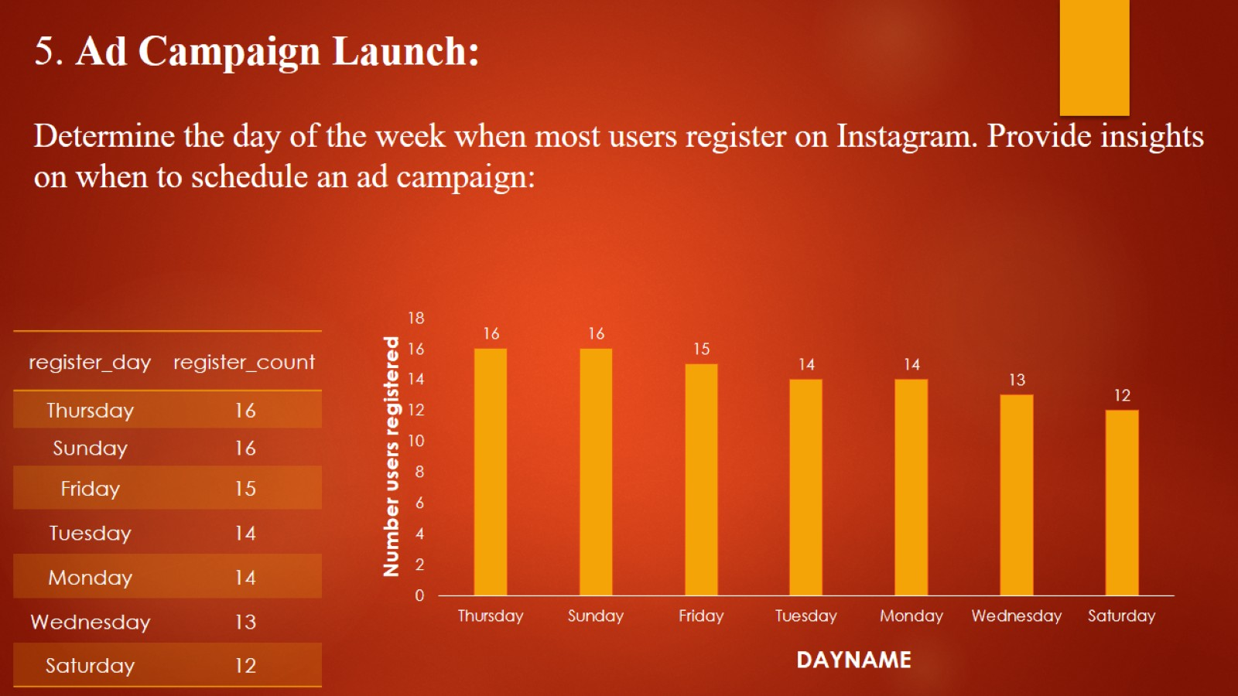
5. Ad Campaign Launch: Determine the day of the week when most users register on Instagram. Provide insights on when to schedule an ad campaign:

Slide 12
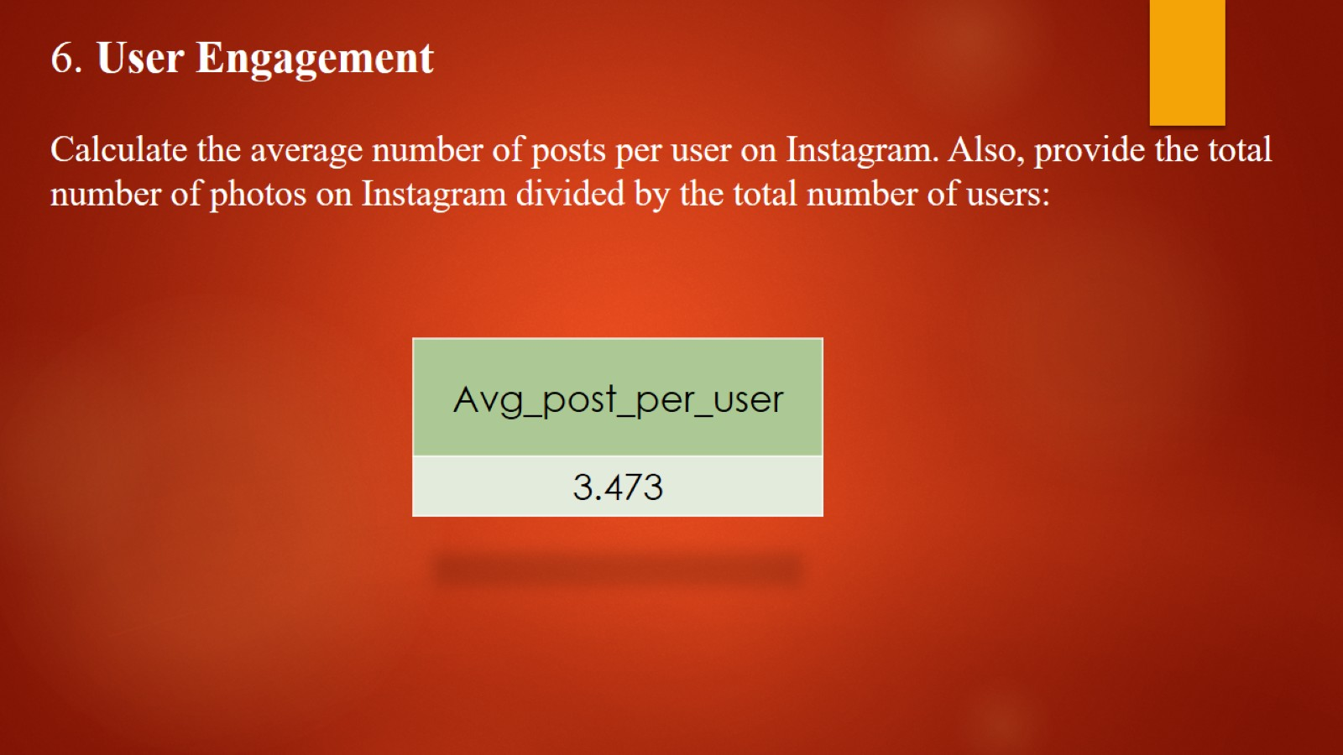
6. User Engagement Calculate the average number of posts per user on Instagram. Also, provide the total number of photos on Instagram divided by the total number of users:

Slide 13
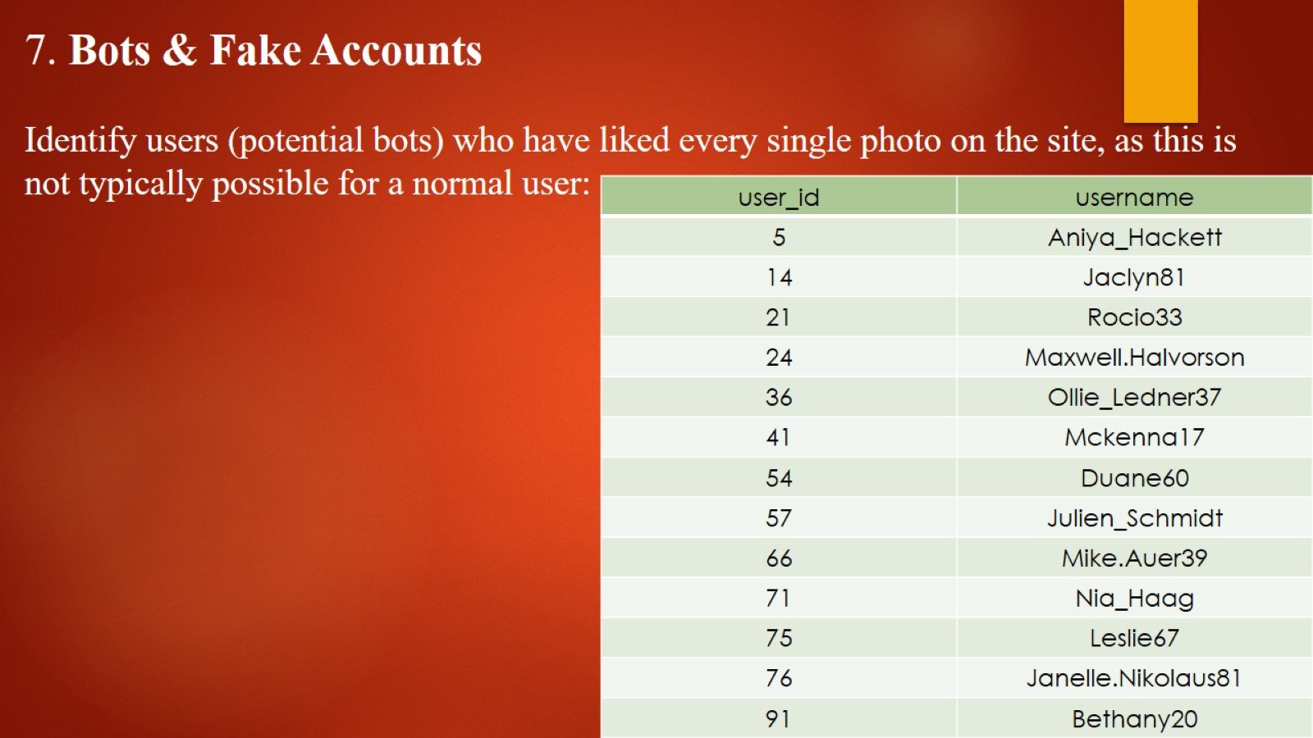
7. Bots & Fake Accounts Identify users (potential bots) who have liked every single photo on the site, as this is not typically possible for a normal user:

Slide 14
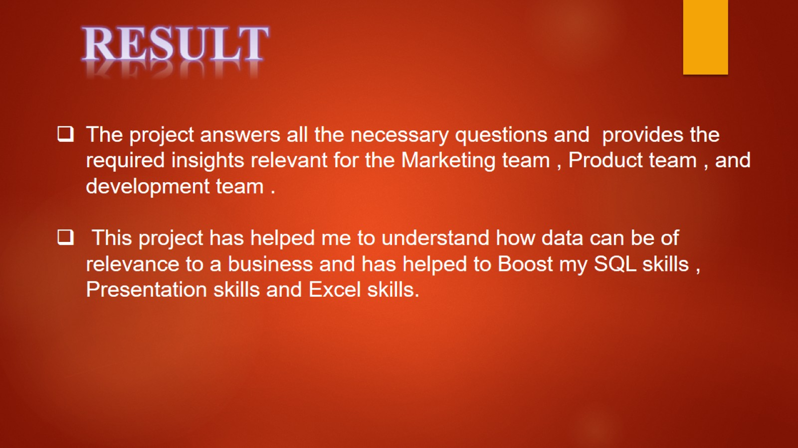
RESULT

Slide 15

THANK YOU

